Slide 1
Advanced GIS Final Project
RTK Machine
Christopher Tillotson
Spring 2025

Slide 2
Presentation overview
1. Mission and Vision
4. Specifics of Approach
Slide 03
Slide 06 - 08
2. Goals and Outcomes
5. Advanced GIS
Slide 04
Slide 09
3. Value
6. Future
Slide 05
Slide 10
Christopher Tillotson
Spring 2025

Slide 3
Mission
Vision
Create a downloadable product consisting of a geodatabase, a python script, and instructions for use, which assists users in planning for drone operations which correspond to the GAGE-associated RTK system on the West coast of the US.
Automated and easy-to-use tools which gives intuitable outputs that can be interpreted, and the structure of which is well documented to be adapted for future use.
Christopher Tillotson
Spring 2025

Slide 4
Goals and Outcomes
Geodatabase of known / supported RTK points in the interest area
Python script which yields the following deliverables, drawing on RTK data
User runs one command, once after importing code, with desired settings to get default deliverables, though command is customizable
Creation of a map visually representing where the nearest RTK points are
Estimated error, recommendations in the output based on estimated error
Customizable RTK point health status
Christopher Tillotson
Spring 2025

Slide 5
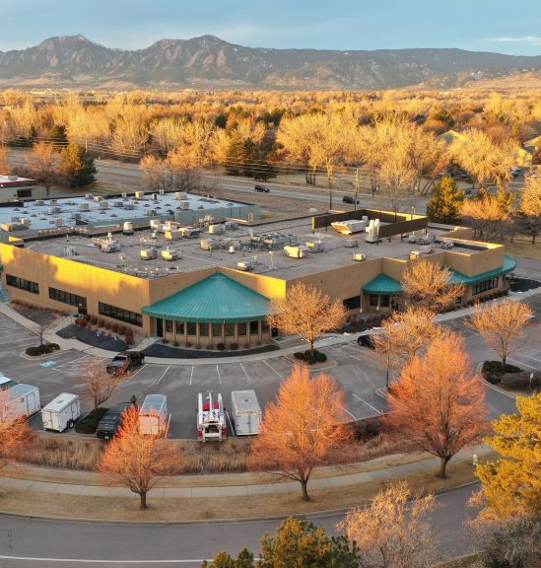
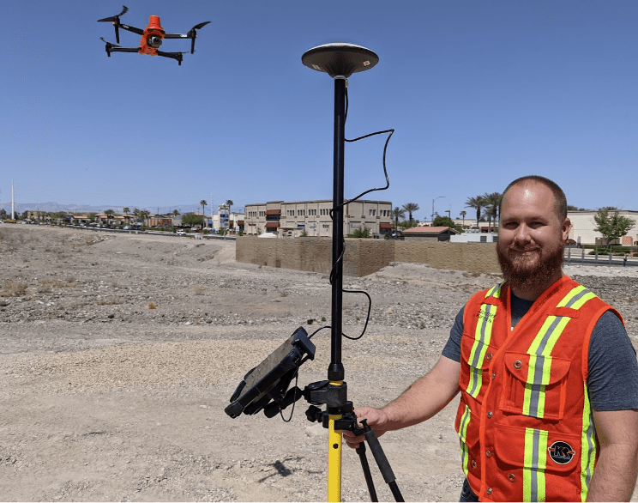
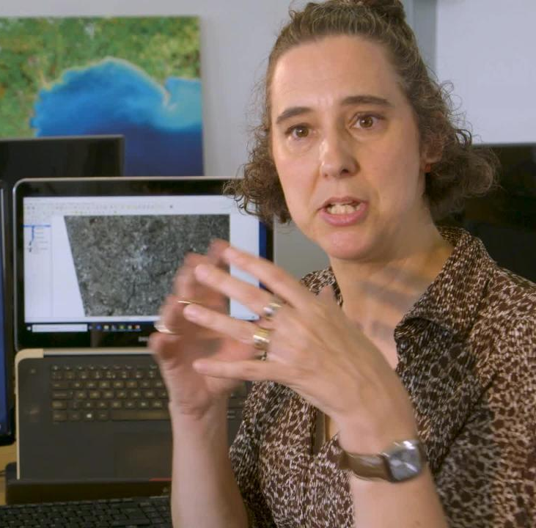





Value
RTK Provider
Drone Pilots
Public and Scientists
Government Entities
Improved ease of use of GAGE-associated RTK systems
More often yield accurately georeferenced data for UAV-collected data on the West Coast
Improved ease of use of GAGE-associated RTK systems as sponsors of GAGE, government use of RTK systems improved (cost to taxpayer reduced, reputation and funding)
Improved planning for RTK system use, accounting for error, and budget considerations for buying or using a custom base station
Christopher Tillotson
Spring 2025

Slide 6
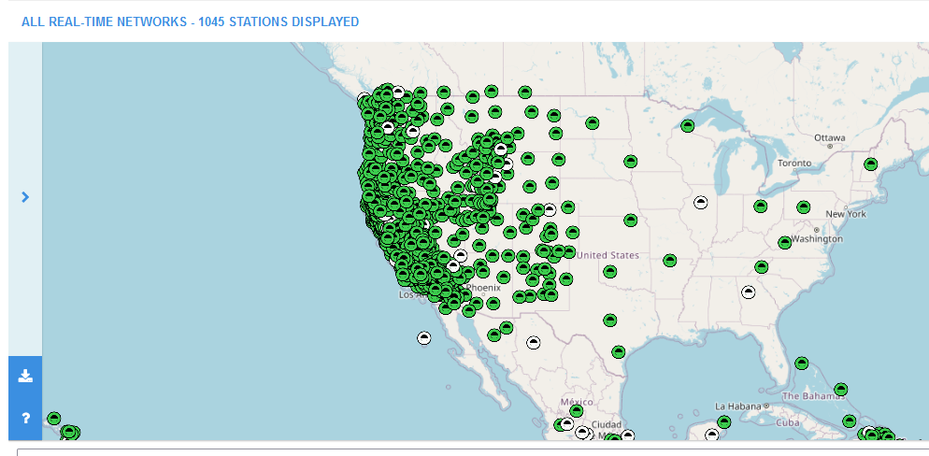
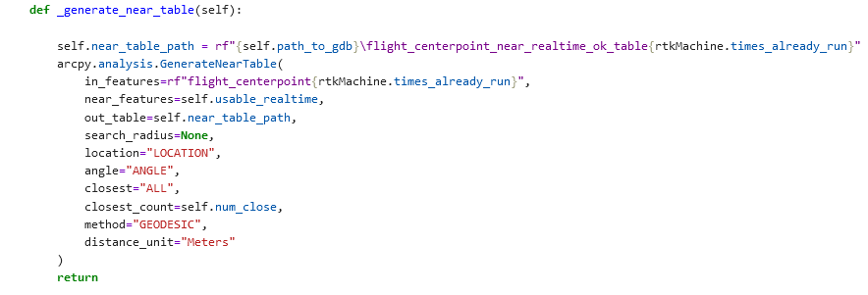
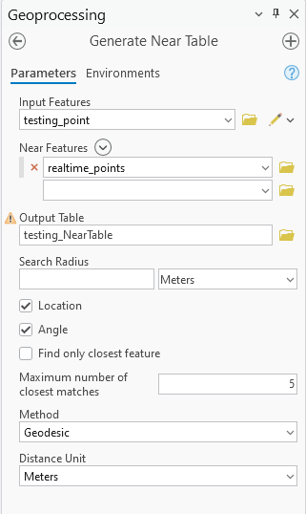
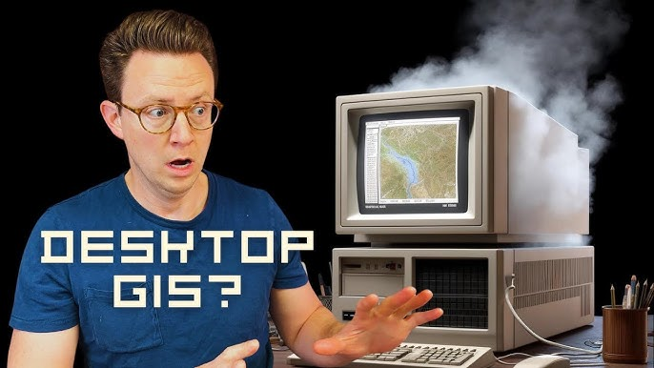
High-Level Strategy
1
Assemble data
3
Implement working tools in a python script
2
Test methods manually with analysis tools in ArcGIS Pro
4
Cycle of testing, breaking, and implementing checks on a case-by-case basis
Christopher Tillotson
Spring 2025

Slide 7



Technology
Data
01
Techniques
03
All real-time networks hosted by GAGE
https://www.unavco.org/instrumentation/networks/status/all/realtime
Mostly Python, focusing on arcpy functions
Had to implement some SQL for queries
Software
02
ArcGIS Pro
Map
Testing on a Jupyter Notebook
WM Jupyterhub for hosting static python script
Christopher Tillotson
Spring 2025

Slide 8
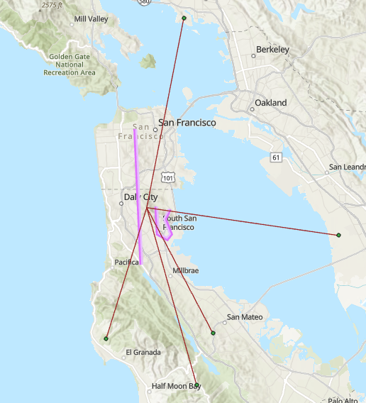
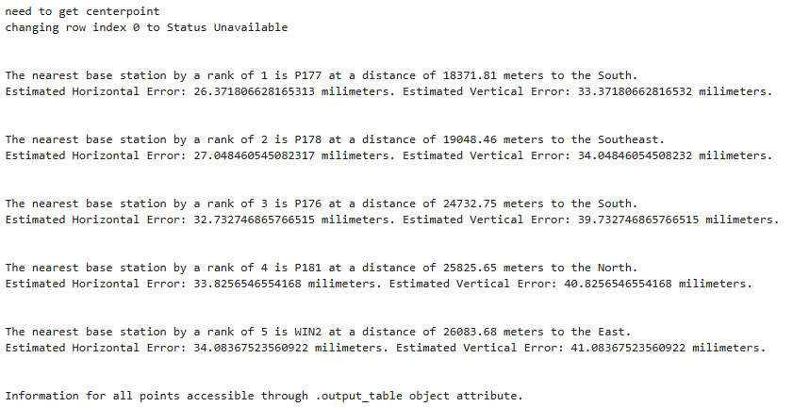
Results
Visual
Information output
Reflection
List 3 or more feature benefits
Add a benefit
Add a benefit
Rabbit holes
Scope and Scale
Christopher Tillotson
Spring 2025

Slide 9
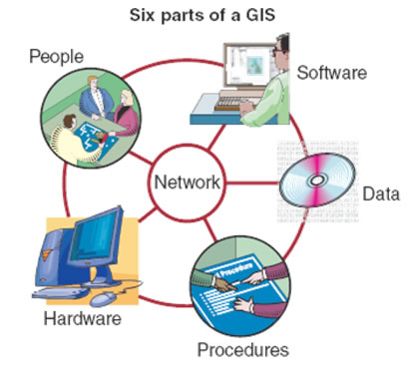
Advanced GIS
Tool / Problem - Solving
Open Source
This project’s outcome is a tool which can be used to assist in RTK data collection and solves the problem of having to estimate error to plan whether or not to use a custom base station
This script is freely available to be used, reproduced, modified, etc by anyone. Limitation is that it is only usable in the context of ESRI software.
Strategy
Scripting
This project was developed with a specific strategy in mind to guide development
Specific concept of programming in a GIS context, automation
Christopher Tillotson
Spring 2025
Notes:
Image adapted from the San Diego State University website Geographic Information Science and Spatial Reasoning at http://map.sdsu.edu/geog104/images/unit-1/six_components.jpg. Accessed 8 January 2018.

Slide 10
Next steps
This project has the possibility to dramatically expand in scope
Rabbit Holes
Explore more possible features, customization
Data
Increase scope of data to include more networks, apply to a larger area, integrate data from multiple sources
Realtime, Arc EB
Try to implement similar designs but live-streaming data, and possible in Experience Builder for accessibility
Christopher Tillotson
Spring 2025

Slide 11








Organization
Geospatial Strategy Canvas
1. Mission
2. Value Proposition
How to define success
Values (or Principles)
Automation | Customization | Documentation / Thoroughness
Mission: Create a downloadable product consisting of a geodatabase, a python script, and instructions for use, which assists users in planning for drone operations which correspond to the GAGE-associated RTK system on the West coast of the US.
Vision: Automated and easy-to-use tools which gives intuitable outputs that can be interpreted, and the structure of which is well documented to be adapted for future use.
Goals and Outcomes
Geodatabase of known / supported RTK points in the interest area
Python script which yields the following deliverables, drawing on RTK data
User runs one command, once after importing code, with desired settings to get default deliverables, though command is customizable
Creation of a map visually representing where the nearest RTK points are
Estimated error, recommendations in the output based on estimated error
Customizable RTK point health status
RTK provider: improve ease of use of GAGE RTK system
Government: same as above (GAGE funded by NSF)
Drone pilots: make planning for RTK use easier
Public / scientists: more often yield accurately georeferenced data
Understand
3. Strategy
How we achieve success
Assemble Data
Download RTK data from GAGE website
Assemble state polygons from appropriate source (for purposes of projecting)
Package into geodatabase
Script
Develop a script which takes in customizable parameters and outputs the deliverables
Document well, and comment, and organize code so that it can be easily adapted for future use
Script should basically take in desired parameters and only have to be run once to get deliverables
Outputs of Script + Data
Map to visualize nearby RTK points
Anticipated error
Recommendations of setting up an RTK control tower
Custom error message if outside of bounds of RTK system
Stretch Goals
Input by manual entry of coordinates (will first design by inputting coordinates/ flight path / flight area as point, line or polygon feature, to be created beforehand)
ArcGIS Experience Builder which allows a user to click a location, rather than type in coordinates or input feature
Plan
Outcomes
Have a completed geodatabase of current RTK system and health, and customizable / updateable if user has more up to date data
Outcomes
Have an easy-to-use script in the determined format which is compatible with the geodatabase
Final Deliverables | Link to GitHub repository with: | README instructions for use Script as a .py file geodatabase
4. Roadmap
Our plan of action
Act
Days 1-3
Days 4 - 10
Days 11 -
Plan project and approach
Develop roadmap
Assemble data
Test methods to confirm approach by running tools manually
Assemble data together into a usable database
Test several different use cases (locations)
Develop script based off of same code used by tools
Review, QA/QC
Ask others for input on design of maps, outputs
Write reports and documentation
Ensure code is well documented / commented
Evaluate future uses of such code, create (and implement, time allowing) parameters for outlier use cases

Slide 12

Thank you
Christopher Tillotson | Student
christopher.t.tillotson@gmail.com
Christopher Tillotson
Spring 2025

